Slide 1
Chapter 1
Computer Abstractions
and Technology
只需要掌握8个伟大思想和CPU评价那些

Slide 2
1.1 Introduction

Slide 3
Class of Computers
Classes | PC/Desktop | Server服务器 | Embedded 嵌入式 | SuperComputers
Features | General purpose, variety of software Subject to cost/performance tradeoff | Network based High capacity, performance, reliability可靠 Range from small servers to building sized | Hidden as components of systems Stringent power/performance/cost constraints | High-end scientific and engineering calculations Highest capability but represent a small fraction of the overall computer market
基本原理一致

Slide 4
Computer Generations 经历了4代
ENIAC 埃尼艾克
First Generation – 1946 ~ 1956
Vacuum tubes, programmable (电子管，可编程，图灵完全)
Second Generation – 1956 ~ 1964
Transistor, programming languages (晶体管，高级编程语言开始应用)
Third Generation – 1964 ~ 1971
Integrated Circuit, OS (集成电路，操作系统开始应用)
Fourth Generation – 1971 ~ now
Microprocessor, GUI, Personal Computer (大规模集成微处理器, 图形用户界面, 个人电脑兴起)
Fifth Generation – future
Still in development … …

Slide 5
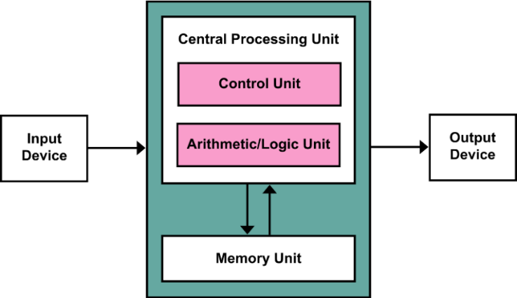
Von Neumann architecture (1945) 冯诺伊曼模型
“存储程序“的概念，采用控制流驱动， 计算与存储分离
按地址访问并且顺序执行行指令
数据与指令保存在同一个存储器，形式上没有区别。指令由操作码和地址码组成
输入设备I
输出设备O
运算器：核心是ALU
控制器：计数器PC（存放下一条指令的地址）,指令寄存器IR（存放当前指令），控制单元PU组成
运算器+控制器=CPU， CPU+主存储器=主机
存储器 存储字长是B（8bit）的整数倍
地址寄存器MAR：存放欲访问的存储单元地址
数据寄存器MDR：存放从存储单元取来的数据
5个部分

Slide 6
RISC processors
MIPS (Silicon Graphics)
PA-RISC (Hewlett Packard)
SPARC ( Sun Microsystems)
Alpha ( Digital Equipment)
PowerPC( Apple, Motorala, IBM)
Motorala 88000
I860, i960 (Intel)
CISC processors复杂指令集:
80x86, Pentium, Penium Pro, Pentium II & III (Intel)

Slide 7
加速
Pipelining 流水线
On board cache 片上寄存器
On board L1 & L2 cache 多级片上寄存器
———————————————————————以下为体系结构
Out Of Order execution 乱序执行
Branch prediction 转移预测（分叉）
Data flow analysis 数据流分析（与编译相关）
Speculative execution 猜测
Multiple issue: Superscaler, VLIW 多发式（一个时钟周期有多条指令）

Slide 8
What is a computer？
Computer is an electronic device that manipulates data according to a list of instructions (program), with capability of Turing machine.
Electronic realization 电子化的实现方式
A set of instructions in a well-defined manner 有指令集 → general-purpose
Execution of a pre-recorded list of instructions 可执行指令 → program-controlled
Memory that can store instructions and data 可存储指令与数据 → stored program
Turing-complete in theory 计算能力上是图灵完全 → equivalent to Turing machine

Slide 9
1.2 Eight Great Ideas in Computer Architecture

Slide 10
Design for Moore’s Law （设计紧跟摩尔定律）
Use Abstraction to Simplify Design (采用抽象分层简化设计)
Make the Common Case Fast (加速大概率事件) 优先优化常用功能
Performance via Parallelism (通过并行提高性能:多个流水线并行，行波加法器)
Performance via Pipelining (通过流水线提高性能)
Performance via Prediction (通过预测提高性能)
Hierarchy of Memories (存储器层次结构)
Dependability via Redundancy (通过冗余提高可靠性)
Express elevators in buildings
Increasing the gate area on a CMOS tran，sistor to decrease its switching time
类似福特的工业流水线
Library reserve desk

Slide 11
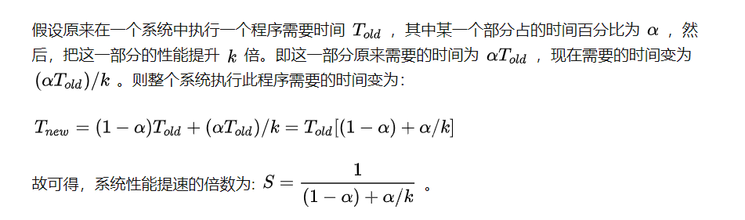
Idea3: Make the Common Case Fast
Amdahl's Law

Slide 12

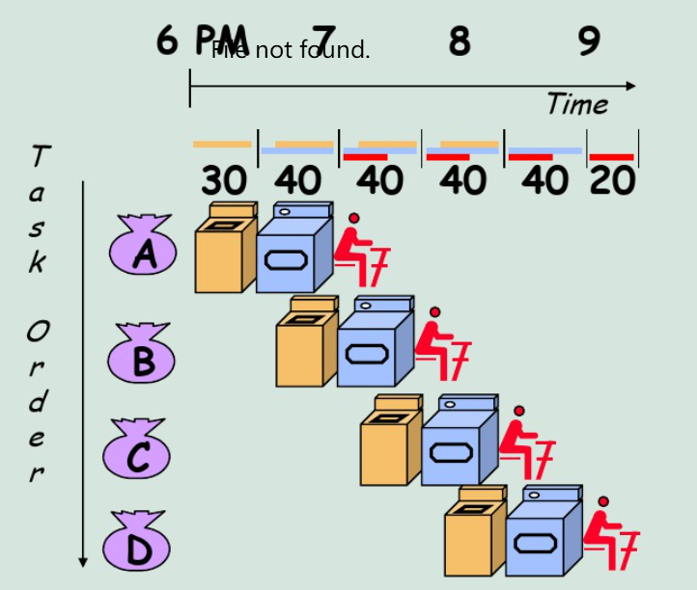


Idea5: Performance via pipelining
Wash: 30minuts
Dryer: 40minuts
Fold: 20minuts
(30+40+20)x4 = 360
30+40*4+20=210
Notes:
四抱衣服总的时间: (30+40+20)x4 = 360

Slide 13
Idea7 :Hierarchy of memories
Hierarchy of Memory
存储大，速度慢 -> 层次化设计
Upper Level
Staging
Xfer Unit
Size / speed
faster
1000B/300ps
64KB/1ns
256KB/3-10ns
2-4MB/10-20ns
4-16GB/50-100ns
4-16TB/5-10ms
Registers
Instr. Operands
prog./compiler
1-8 bytes
Cache
Blocks
cache cntl
8-128 bytes
Memory
Pages
OS
512-4K bytes
Disk
Files
user/operator
Mbytes
Larger
Tape
Lower Level

Slide 14
1.3 Below Your Program

Slide 15
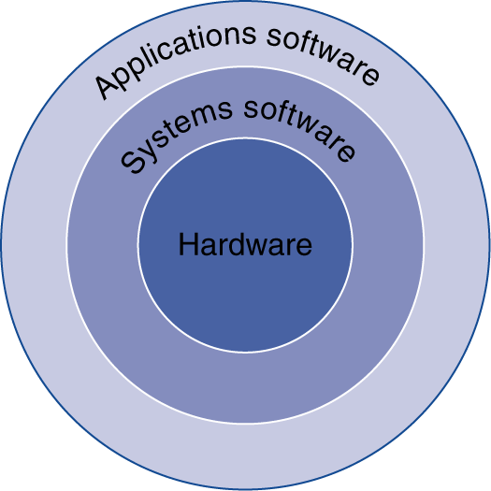
Computer organization
Decomposability of computer systems
Application software(应用软件): word, PPT, office
Software
OS(操作系统)
Compiler(编译器)：GCC
System software
Computer System
Firmware(Driver software):例如：网卡驱动
DBMS
Hardware
硬件和软件具有功能等价性（既可以由硬件实现，又可以由软件实现），硬件具有更高的执行条件，软件具有更好的灵活性

Slide 16
Levels of program code
a[i] = b[i] + c;
High-level programming language(高级编程语言)
Assembly language(汇编语言)
Symbolic notations ex. add A, B
The assembler translates them into machine instruction
Machine language(机器语言)
二进制，计算机唯一能认识的语言
Compiler
lw $15, 0($2)
add $16, $15, $14
add $17, $15, $13
lw $18, 0($12)
lw $19, 0($17)
add $20, $18, $19
sw $20, 0($16)
Assembler
000000101100000
110100000100010
…

Slide 17
A translation hierarchy
编译器：高级语言 → 汇编
汇编器：汇编 → 机器语言

Slide 18
Program execution
Interpreter
Source
Code
Basic
ASP
JS
Editor
解释器：将源程序语句逐条翻译为机器语言并且立刻执行
Java
中间
编
译
Compile
Byte
Code
C、C++
Pascal
Fortran
Object
model
interpreter
Static
Libary
Link
Dynamic
Link Libary
Run
Executable
File
Excute
执行器

Slide 19
1.4 Under the covers computer hardware system

Slide 20
Computer organization
Software
Control unit
Path: multiplexors
ALU: adder, multiplier
Registers
……
CPU
Computer System
其中有控制器
Datapath
Hardware
Memory
Input: keyboard
I/O interface
Bidirectional: RS-232,USB
Output: VGA，LCD

Slide 21
Memory: A safe place for data
Memory(存储): the storage area programs are kept and that contains the data needed by the running programs
Main Memory(主存): volatile; used to hold programs while they are running.( DRAM in computers)
Second memory: nonvolatile; used to store programs and data between runs. (Flash in PMD, magnetic disks)
Volatile (易失性)
DRAM (Dynamic Random-Access Memory):动态随机存储器
SRAM (Static Random Access Memory)：静态随机存储器
Nonvolatile (非易失性)
Solid state memory (Flash Memory):固态硬盘 or 闪存
Magnetic disk (Hard disk) ：硬盘
Memory |  | Price | Speed | Capacity | Used for
SRAM | volatile | / | Fastest | KB~MB | Cache
DRAM | volatile | $3~4/GB | Fast | MB~GB | Main memory
Hard disk | nonvolatile | $0.05~1/GB | Slow | TB~PB | PC Storage
Flash Memory | nonvolatile | $0.75~$1/GB | Medium | GB~TB | PMD Storage

Slide 22
1.6 Performance

Slide 23
Defining Performance
Response (Execution) time 执行时间
user perception
system performance
the only unimpeachable measure of performance 唯一无懈可击的业绩衡量标准
Mobile devices
CPU time
designer perception
CPU performance
Throughput
administrator perception
server
改进性能的方法 | Response time | Throughput
Replacing a faster processor | ↑ | ↑
Adding additional processors for a system use MP for independent task | - | ↑

Slide 24
Response (Execution) time
计算机完成一项任务所需的总时间，包括磁盘访问、内存访问、I/O活动、操作系统开销、CPU执行时间
CPU time
CPU用于特定任务的实际计算时间
Throughput(Bandwidth带宽)
在给定时间内所做的总功
单位时间内完成的任务数
CPU time is further divided into:
User time - time spent in user mode
System time - time spent in OS

Slide 25

Relative Performance
“Performance of P₁ is better than P₂ ” is, for a given work load L, P₁ takes less time to execute L than P₂ does
performance(P1) > Performance(P2)
⇒ Execution Time(P1, L) < Execution Time(P2, L)
“Processor X is n times fast than Y” is

Slide 26
CPU Clocking
时钟周期 Clock Circle Time
主频的倒数
主频（时钟频率）Clock Rate
主频越高完成一个指令所需要的时间越短
CPI cycle per instruction
执行一条指令所需的时钟周期数（时钟频率不影响CPI）
CPU执行时间
Instructions指令条数

Slide 27
CPI是执行所有指令的平均时间周期数

Slide 28
CPI Example
Alternative compiled code sequences using instructions in classes A, B, C
Class | A | B | C
CPI for class | 1 | 2 | 3
IC in sequence 1 | 2 | 1 | 2
IC in sequence 2 | 4 | 1 | 1
Sequence 1: IC = 5
Clock Cycles = 2×1 + 1×2 + 2×3 = 10
Avg. CPI = 10/5 = 2.0
Sequence 2: IC = 6
Clock Cycles = 4×1 + 1×2 + 1×3 = 9
Avg. CPI = 9/6 = 1.5

Slide 29
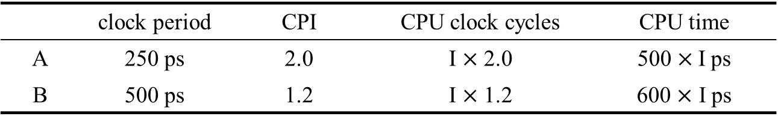
Example：Which is fast and by how much ?
 | clock period | CPI | CPU clock cycles | CPU time
A | 250 ps | 2.0 | I $×$ 2.0 | 500$×$ I ps
B | 500 ps | 1.2 | I $×$ 1.2 | 600 $×$ I ps
Answer: CPU PerformanceA Execution TimeB 600 * I ps
--------------------------- = -------------------------- = ------------------- = 1.2
CPU PerformanceB Execution TimeA 500 * I ps

Slide 30
Architecture --> Implementation --> Realization
Compiler Designer Processor Designer Chip Designer
Hardware / Software | Affects what ? | How?
Algorithm | IC, possibly CPI | Favoring instructions
Programming language | IC, CPI | Java : indirect calls
Compuiler | IC, CPI
Instruction set Architecture | IC, CPI, CC
Organization | CPI, CC
IC | CC

Slide 31
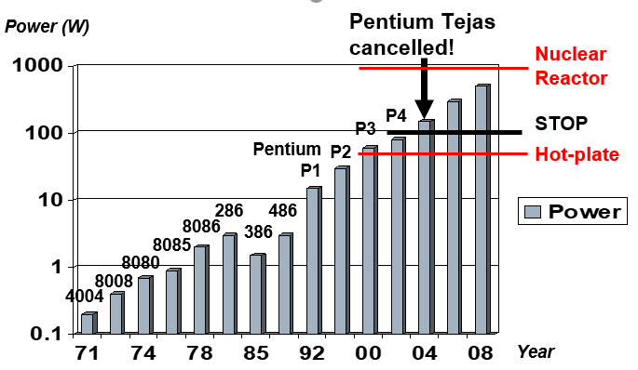
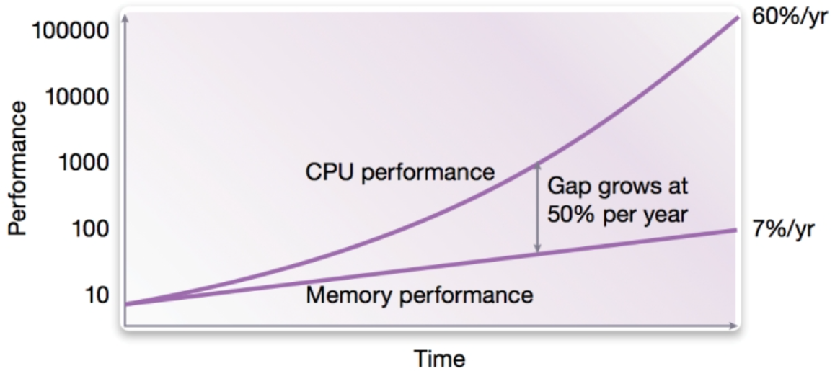
Challenges of the processor
处理器和存储器性能的提高不成比例，“内存墙”问题日趋严重，“冯诺依曼”架构面领挑战。
单位面积功耗增大，散热问题日趋严峻，“功耗墙”问题凸显。
受物理规律限制，摩尔定律面临失效，靠工艺进步获得的性能红利逐渐减弱。
Memory Wall（内存墙）
Power Wall(功耗墙)
工艺发展限制

Slide 32
